Slide 1
St Louis Public School District Spirit of excellence
Adam Benckendorf
Class of 2012
Metro High School

Slide 2
Washington University School of Medicine Saturday Scholars Program
Saturday Scholars, under the direction of Dr. Will Ross,met
at Washington University School of Medicine this past spring. Metro students were selected byIB Biology instructor,
Ms. Kerry Zimmerman. Our group’s research presentation focused on atrial fibrillation.

Slide 3
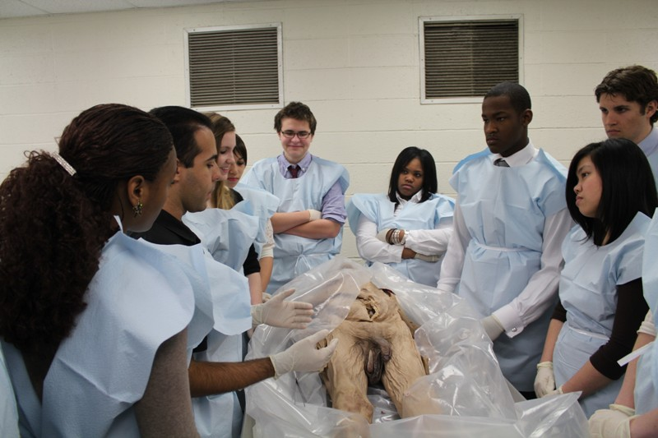
Highlights
Lecture and lab highlights at Washington University School of Medicine were …
- cardiovascular system
- respiratory system
- gastrointestinal system
- reproductive system
- introduction to radiology
- anatomy lab, museum, medical library
Because of this challenging program, I am very interested in pursuing a career in medicine.

Slide 4
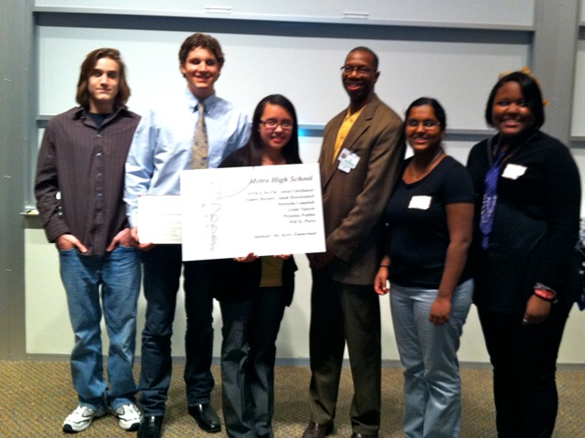
Dr. Will Ross with Metro Students

Slide 5
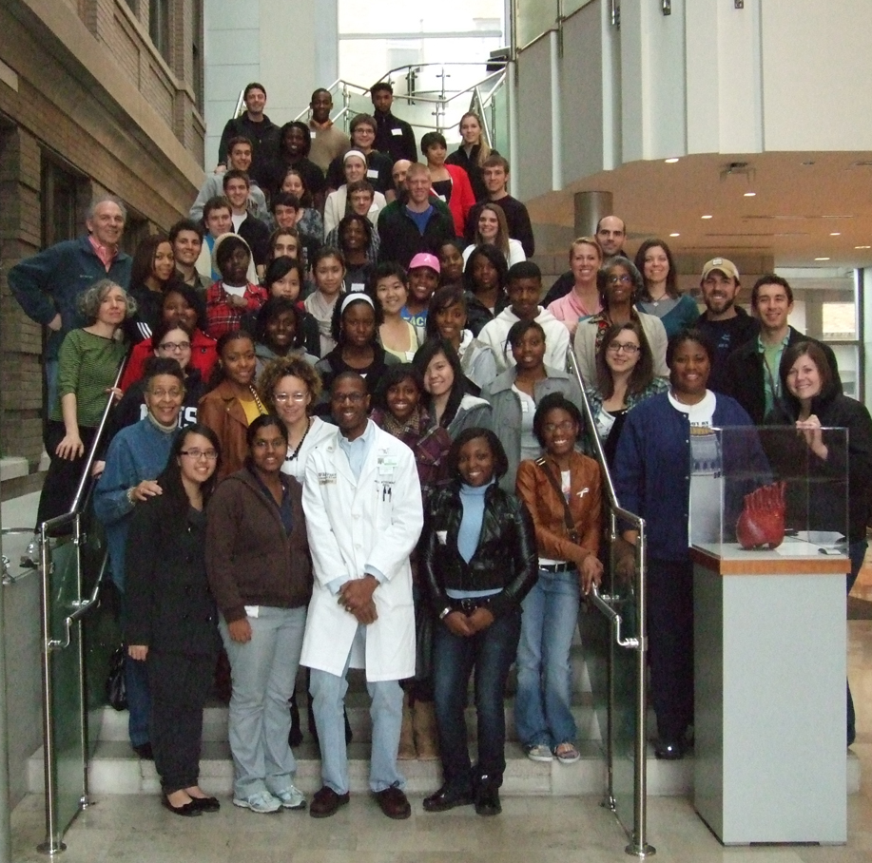
Saturday Scholars

Slide 6
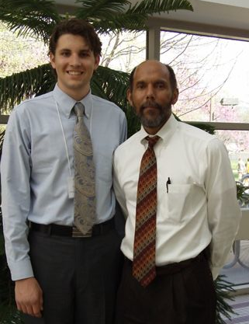
Excellence in Learning at the University of Missouri, Columbia
Over a weekend we went to MIZZOU for the Excellence in Learning Program under Dr. Ellis A. Ingram.
There, we participated in a Problem Based Learning Workshop with medical students.
We also attended a surgery workshop, and shadowed a medical professional.

Slide 7
Learning IV Insertion
The final session was held at University of Missouri in Columbia’s School of Medicine. We attended various simulation stations, such as learning to insert IVs … sim blood and all.

Slide 8
How To Intubate
This is much trickier than it looks … I think I pumped air into the stomach instead of the lungs.

Slide 9
Playing Games
We navigated laprascopic instruments and moved monkeys into the barrel. Teamwork and hand to eye coordination were critical in getting the job done.

Slide 10
Meeting “METIman”
He was no dummy. METIman actually spoke to us (thanks to the person behind the curtain) and demonstrated CPR.
Notes:
He was no dummy. METIman actually spoke to us (thanks to the person behind the curtain) and demonstrated CPR.

Slide 11
METIman’s Pulse Surprises!
While METIman was speaking to us … someone touched his foot. To our surprise he had a pulse there!

Slide 12
Shadowing in the MRI Dept
Shadowing Mark Burton in the Radiology Department, I observed the MRI of an injured athlete.

Slide 13
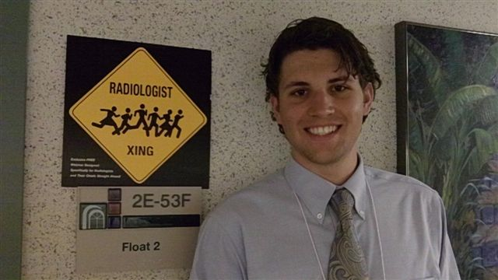
MRI Demo – Don’t Try This At Home
Never, ever, enter an MRI zone without first emptying your pockets. We found out how fast metal can fly in a magnetic field.

Slide 14
Mizzou Recognition
An amazing day at Mizzou’s Med School campus with many thanks to the wonderful staff, especially Dr. Ingram and Ms. Brown.

Slide 15
HPREP Field Trip at the Washington University School of Medicine
This field trip included a suturing lab, gross anatomy lab, microscopes and x-rays observation, as well as patient simulation.

Slide 16
With Sincere Thanks …
I am honored to be recognized by The St Louis
Public School District as a Spirit of Excellence
Honoree.
Thank you to everyone who made opportunities like these possible for SLPS students like me … especially to Dr. Ellis Ingram, Dr. Will Ross, Ms. Shirley Brown and Ms. Kerry Zimmerman.
Notes:
Photo credits L. Benckendorf

